Slide 1
General Meeting
10h - 12h
17 June 2014
ASBL: 874.358.592 | Avenue Victor Gilsoul 1 - 1200 Brussels - Belgium

Slide 2
Agenda
Welcome by Beckie Metelko
Welcomes and Farewells by Beckie Metelko
Approval of Minutes from 20 May 2014
Treasurer Update by Alessandra Foresti
Membership by Trine Lauvsnes
Bazaar Update by Emily Michnay
Fundraising Ideas by Hilde Broeks, NR - Netherlands
Coffee Break (15 minutes)
Charity Update by Sylvi Smellror
Tombola Update by Carla Bucalossi Quatrini
Restaurant Update by Christina Arvanitaki
Sponsorship & Events Update by Dionysia Leolei
Any other Business and Closing by Beckie Metelko

Slide 3
Farewell to Members (1 of 2) Beckie Metelko – Vice-President
Francine Pilon, ANR, Canada
Bohumila Balounova, NR, Czech Republic
Pia Rohrmann, ANR, Germany
Krisztina Rajcsányi-Müller, ANR, Hungary
Cristina Pedrinazzi Andriulli, NR, Italy
Barbara Ghetti, ANR, Italy
Lena Marie Fekene, NR Norway
Katarzyna Ochman, NR, Poland

Slide 4
We will always remember the friendship we have shared It was a great pleasure and privilege to be part of this fantastic group. As Saint Exupery said "Those who pass by us, do not go alone; do not leave us alone. They leave a bit of themselves; they take a bit of us. " Thank you all

Slide 5
Farewell to Members (2 of 2) Beckie Metelko – Vice-President
Maria Isabel de Paiva Mateus, NR, Portugal
Rute Marques, ANR, Portugal
Christina Ribeiro, 2nd ANR Portugal
Célia Martins, 2nd ANR Portugal
Ljiljana Desancic, ANR, Serbia
Gabriela Slodicková, NR Slovakia
Markéta Kolláriková, ANR, Slovakia
Ivaylo Toshirov, ANR, Bulgaria

Slide 6
Welcome to Members – 1 of 2 Beckie Metelko – Vice-President
Doris Bachler, ANR, Austria
Vernoika Strakova, 2nd ANR, Czech Republic
Stephanie Klein, ANR, Germany
Eleni Zaxariadi, NR, Greece
Morgana Mastrocinque, NR, Italy
Lucia Morlacchetti, ANR, Italy
Fatima Serodio, NR, Portugal
Welcome on Board ☺

Slide 7
Welcome to Members – 2 of 2 Beckie Metelko – Vice-President
Kamila Kocianova, NR, Slovakia
Mia Werin, NR, Sweden
Katharina Garbe, ANR, Switzerland
Linda Starflinger, NR, United Kingdom
Tiffany Boatwright, ANR, United Kingdom
Rowena Cookson, 2nd ANR, United Kingdom
Welcome on Board ☺

Slide 8
VOTES Beckie Metelko – Vice-President
Approval of Minutes from 20 May 2014

Slide 9
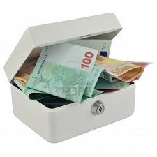
Treasurer Update Alessandra Foresti Bertozzi - Treasurer
CONTRIBUTION 2014
4.568 EUROS
On 15 June 2014
Hulencourt ticket sale
Small change for a Big change
June Bake Sale
Notes:
9
9
9

Slide 10
Membership Database Trine Lauvsnes– Membership Coordinator

Slide 11
Membership Database Trine Lauvsnes– Membership Coordinator

Slide 12
Bazaar Update Emily Michnay - Bazaar Coordinator
Participation Questionnaire – Status
Key Dates Reminder
Preliminary Instructions
Group Picture for the Tri-fold
« Members Only » Section of Web Site

Slide 13
Participation Questionnaire 2014
NOT RECEIVED = 10
RECEIVED = 33
Albania
Artist Corner
Azerbaijan
Bulgaria
France
Georgia
Iceland
Luxembourg
Ukraine
United Kingdom
Final Due Date
TODAY

Slide 14
Key Dates Emily Michnay - Bazaar Coordinator
Bazaar: 16 November 2014
After Sales: 24-28 November 2014
1 week later than last year

Slide 15
Bazaar Preliminary Instructions Emily Michnay - Bazaar Coordinator

Slide 16
Not Receiving Emails?
Email membership@natocharitybazaar to ensure we have your correct email address
Add “postmaster@natocharitybazaar” to your email contact list

Slide 17
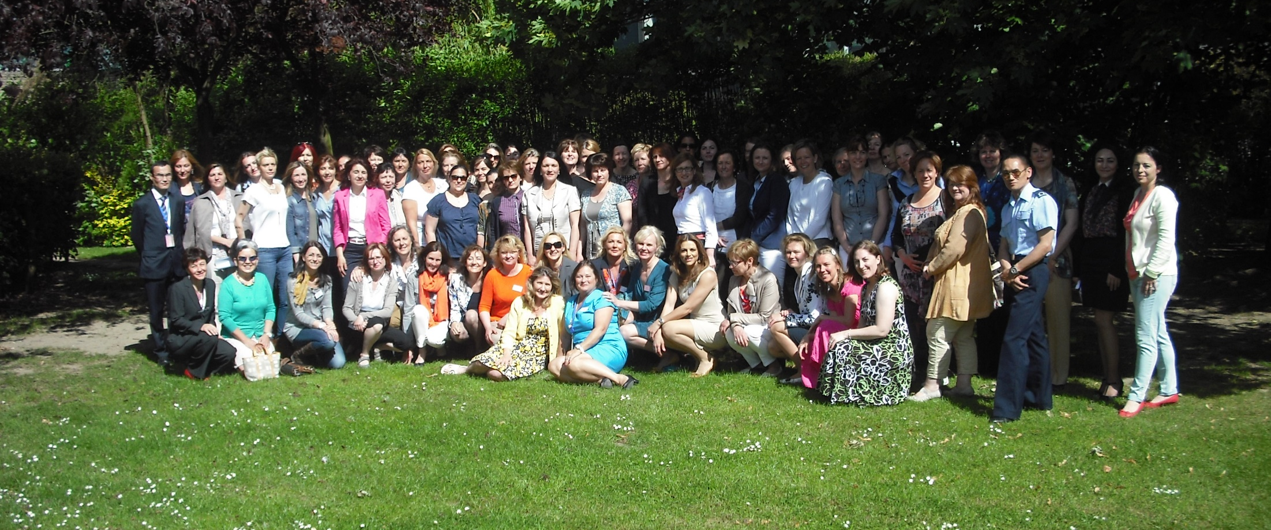
Group Picture for Tri-fold 2014 Emily Michnay - Bazaar Coordinator

Slide 18
Hilde Broeks
National Representative, The Netherlands
Fundraising Ideas

Slide 19
Coffee Break 15 min

Slide 20
Charity Update Sylvi Smellror
Application status for Belgian and International Charities
Belgian Charity Visits Agenda + Form
Explanation of the Charity Selection Vote will take place at September 9th General Meeting

Slide 21
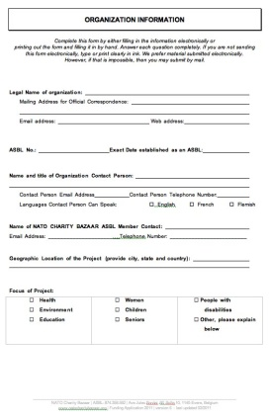
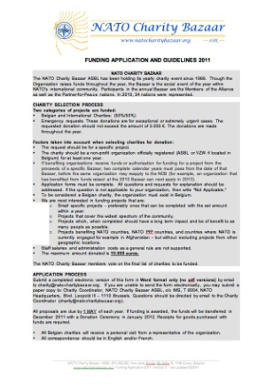
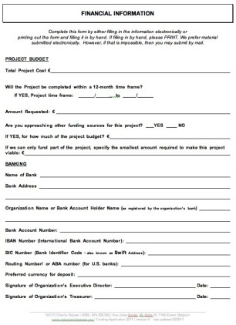
Charity Funding Applications
Belgian Charities
10 Eligible Applications
Group 7: Still looking for a date

Slide 22
Charity Visits 1/2

Slide 23
Charity Visits 2/2

Slide 24
Conducting a Charity Visit Sylvi Smellror
Fill out the ‘2014 Belgian Charity Visit Form’ during the visit (please find on Members Only area)
After the visit, email the completed form to the Charity Team at charity@natocharitybazaar.org
All visits should be completed by 30 June 2014
The completed visit forms will be posted on our website after the voting in September.
Please remember not to talk to anyone other than your visit group and the Board about your Belgian charity visits (secret voting).

Slide 25
Charity Funding Applications
International Charities
67 Application received
30 Applications rejected (3 applications per country rule)
37 Applications reviewed
25 Eligible Applications

Slide 26
Charity Vote Sylvi Smellror
The charity vote will take place at the September 9th General Assembly Meeting
On or before September 1st you will receive an e-mail containing the Pre-briefing Booklet in pdf format. This booklet lists the project summaries and breakdowns from all eligible charity applicants, as well as target and number of beneficiaries, total project cost and amount proposed by the Board.
The final Briefing Book including the name, the country and one or more pictures of the applying charity organization/project will ONLY be available on our web-site AFTER the charity vote.

Slide 27
Tombola Overview Carla Bucalossi Quatrini - Tombola Coordinator
Tombola - A giant raffle
Tickets price: 2.50 € each
Prizes - Each nation provides at least two (2) prizes worth at least 100 € each
Ticket Sales - All nations sell tickets
Winners - The winners are drawn at the Bazaar

Slide 28
Tombola Prizes Carla Bucalossi Quatrini - Tombola Coordinator
At least two (2) prizes per nation
Each prize must be worth at least 100 €
Provide list of prizes in September
Find the Prize list Form on the website > Members Only > Forms

Slide 29
2014 Tombola Ticket Sales Carla Bucalossi Quatrini - Tombola Coordinator
Tombola Sales in front of ING Bank (Press Hall)
Sept 29-Nov 7

Slide 30
Restaurant Update Christina Arvanitaki - Restaurant Coordinator
Latest Update
Each nation need to find a Restaurant Coordinator + Ass. Restaurant Coord.
2014 Forms will be on our website
1-2 special restaurant coordinator meetings before the bazaar

Slide 31
Sponsors & Events Dionysia Leolei, Sponsors & Event Coordinator
Latest Update
Confirmed Sponsor NCB 2014
PLATINUM SPONSOR

Slide 32
Sponsors & Events Dionysia Leolei, Sponsors & Event Coordinator
BOOK PRESENTATION & SALE
30 books signed by the author sold
Total: 600,00 €
20 more copies available TODAY
20 € / Book

Slide 33
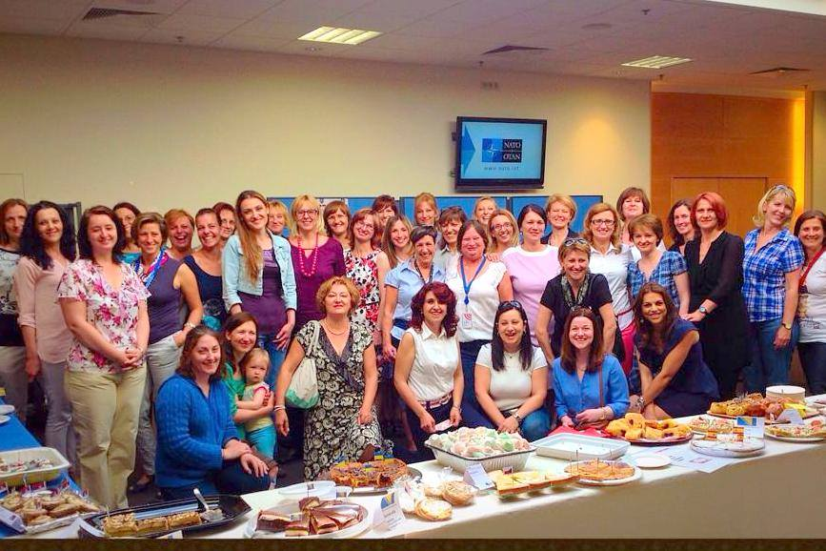
Bake Sale
June 12 2014 Raised: 1168,14€
Total for 2014: 3087,14 €
Next Bake Sale - September 25, 2014

Slide 34
Sponsors & Events Dionysia Leolei, Sponsors & Event Coordinator
Photo Exhibition 1-3 July
Opening Ceremony 1st of July 11:00

Slide 35
Closing Beckie Metelko – Vice-President
New Webmaster & Assistant Webmaster!
Johan Van Roste
Ludmilla Nováková
Mrs. Anne-Mette Rasmussen is host at:
Summer Charity Ball on June 21st at 19h30
Tickets are sold out
Please return Voting Cards and blue Folders

Slide 36
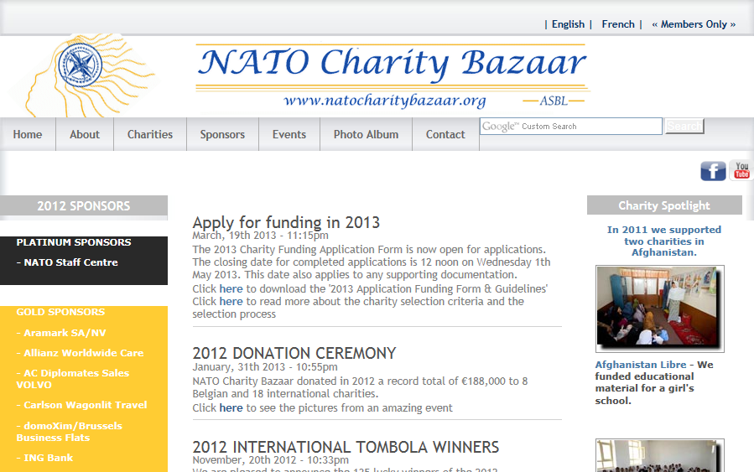
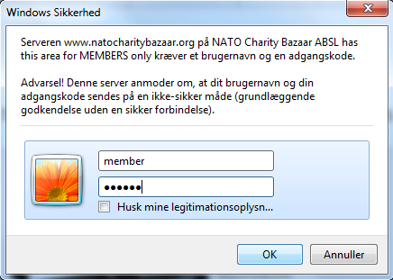
Web Site Access
www.natocharitybazaar.org
User Name: member
Password: member
User Name: members
Password: members
User Name: membre
Password: membre

Slide 37
Closing Beckie Metelko – Vice-President
General Meeting Dates 2014
9 September
Key Focus: Charity Vote
23 September
Key Focus: Tombola Ticket Sales Lottery, Bazaar Instructions & Call for Entertainment
07 October & 21 October
Key Focus: VIP & Visitor Passes
12 November
Key Focus: Final Instructions & After Sales Schedule
Please return voting cards and folders

Slide 38
Sponsors & Events Dionysia Leolei, Sponsors & Event Coordinator
Behind the Silk Curtain
20 more copies available NOW
20 € / Book

Slide 39
Just to the Board Suggestion sent
Board Meeting Dates 2014
September 2, 16, 30
October 14
November 4
Bazaar 2013 - Sunday 17 November

